Slide 1


Introducing Microsoft Fabric

Slide 2
Agenda
What Is Fabric
Why Fabric
OneLake
Single Source of Truth
Report Demo
Pricing
PowerBI Copilot video
How to enable in your organisation
Notes:
What is Fabric
End to End Analytics Platform
Key Points
One Lake
Single source of truth
PowerBI Copilot
Pricing
How to set up environment

Slide 3

Microsoft Fabric
Infrastructure simplification
Improve operations efficiency
Data Governance
Notes:
Top level focus

Slide 4

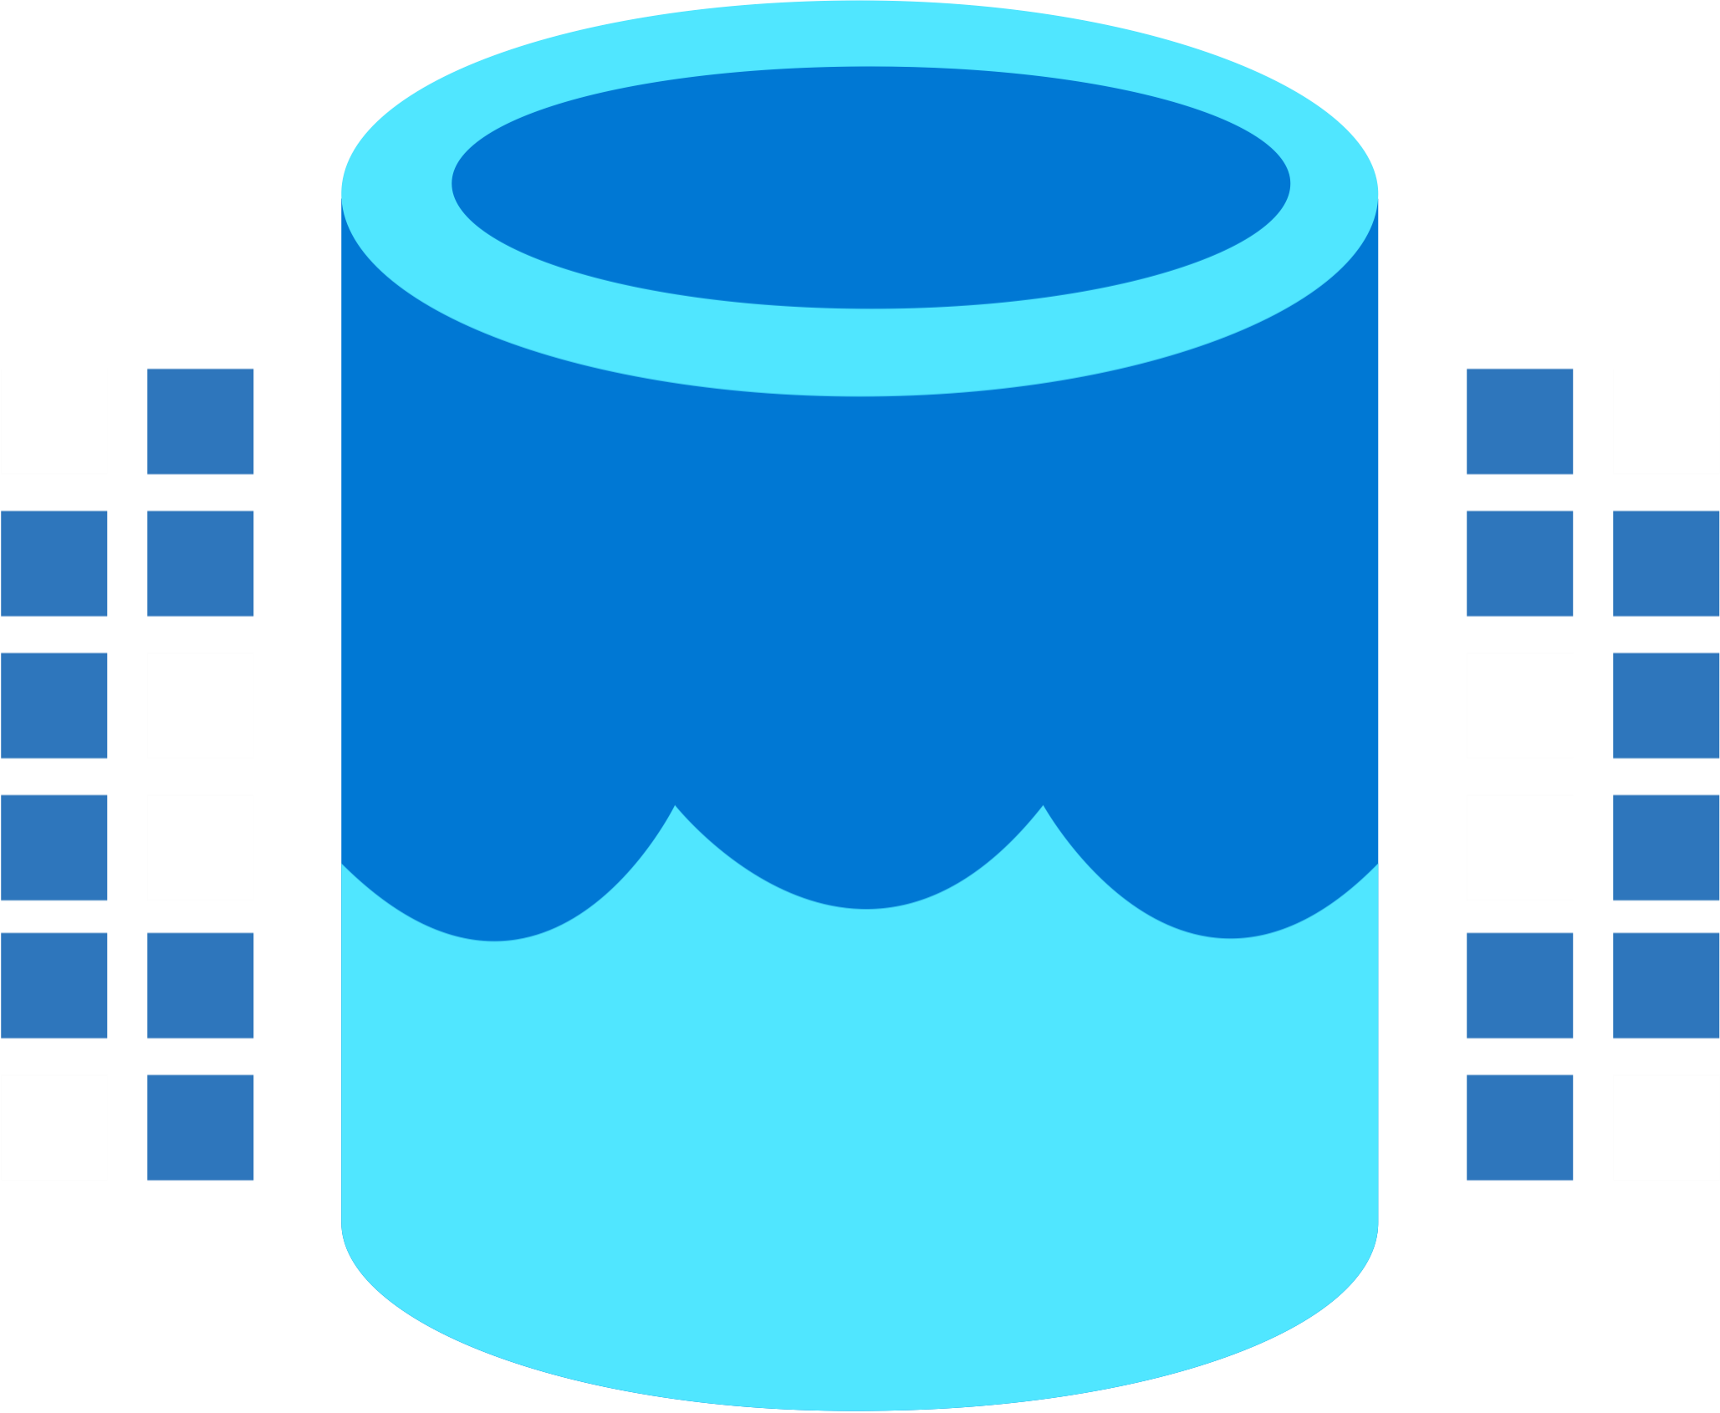
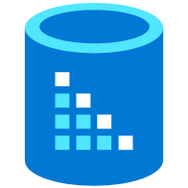



Microsoft Fabric
Data Integration
Data Lake
Spark Engines
Data
Warehouse
Real Time Analytics
Data
Science
Business
Intelligence
Governance
Unified analytics fabric
End-to-end analytics data fabric
From the data lake to the business user
Notes:
Microsoft Fabric is an all-in-one analytics solution for enterprises that covers everything:
data movement
data science,
Real-Time Analytics,
and business intelligence.
It offers a comprehensive suite of services, including data lake, data engineering, and data integration, all in one place.
With Fabric, you don't need to piece together different services from multiple vendors. Instead, you can enjoy a highly integrated, end-to-end, and easy-to-use product that is designed to simplify your analytics needs.
The platform is built on a foundation of Software as a Service (SaaS) model, which takes simplicity and integration to a whole new level.
With Microsoft Fabric, we go from a collection of products to a Unified Analytics Platform that brings end-to-end analytics from the data lake to the business user

Slide 5







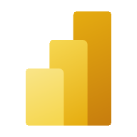



Microsoft Fabric
Microsoft Synapse
Data Factory
Synapse
Data Engineering
Synapse
Data Science
Synapse
Data Warehouse
Synapse
Real-Time Analytics
Power BI
Data Activator
Copilot
OneLake
Notes:
Vs Synapse comparison short
Azure Data Factory provides a standalone experience for creating Pipelines.

Slide 6
Why Fabric
Democratize Analytics
Persona Experience
Simplify
Operations
Deployment
Administration/Management
Pricing
Single Source of Truth
OneLake
One Security
Open but Secure
Part of Microsoft Platform
Seamless integration
Data
Integration
Data
Engineering
Data Warehousing
Real-
Time Analytics
Data Science
Business Intelligence
AI Assisted
Shared Workspaces
Universal Compute Capacities
OneSecurity
OneLake
The Intelligent Data Fabric
Notes:
Microsoft Fabric is build around Persona centric workflow (starting from Data Engineer to a Citizen Data Analyist). Each Role or Persona is presented with a set of tasks and work windows typically associated with them. For example Data Engineer will be mostly interested in Pipelines, Notebooks and perhaps SQL Endpoint, whereas Citizen Data analysts will be interested in Semantic Data Models (formerly known as DataSets) available in the organisation and reports that can be built on top of them.
The aim is to simplify all aspects of Business Intelligence and Analytics in the organisation, where previously you needed to deploy multiple products from variety of vendors, in Fabric with simple 1 click deployment you will have all the features necessary. Even compared with a traditional Synapse deployment containing dozen of Azure Services in Fabric it is all rolled into one.
One Lake is a single, unified, logical data lake for your whole organization. Like OneDrive, OneLake comes automatically with every Microsoft Fabric tenant and is designed to be the single place for all your analytics data. To separate the data between different users or business group Lakehouses are used and you can deploy as many as you like.

Slide 7
Microsoft Fabric
End-to-end analytics data fabric
From the data lake to the business user
Complete Analytics Platform
Best of Breed
Unified SaaS Solution
Low Code Plus Pro Dev
Lake-centric and Open
OneLake
One Copy
Always Synced
Empower Every Office User
Familiar and Intuitive
Built Into Office
Insight to Action
Persistent Security and Governance
End-to-End Visibility
Always Governed
Secure by Default
Notes:
Microsoft Fabric integrates Power BI, Data Factory, and the next generation of Synapse to offer customers a price performant and easy-to-manage modern analytics solution for the era of Artificial Intelligence.
Microsoft Fabric delivers an integrated and simplified experience for all analytics workloads and users on an enterprise grade data foundation. It is a product for the entire enterprise—complete with role-tailored tools, deep integrations with Microsoft Office and Teams, and AI Copilots to accelerate analytics capabilities and help scale data value creation for everyone from data professionals to non-technical business users. It enables persistent data governance and a single capacity pricing model that scales with your growth—and it’s open at every layer with no proprietary lock-ins. With Microsoft Fabric, you can empower everyone to unlock more value from data.

Slide 8
It’s SaaS
“it just works”
5x5
Frictionless onboarding
Instant Provisioning
Quick Results w/Intuitive UX
Success by default
Minimal knobs
Auto optimized
Auto integrated
Centralized Administration
Tenant-wide governance
Centralised security management
Compliance built-in
Notes:
5x5 = 5 seconds to sign up
5 minutes to wow

Slide 9
OneLake for all Data
“The OneDrive for Data”
Data
Warehousing
Data
Engineering
Data Integration
Data
Science
Real
Time
Analytics
Business Intelligence
A single SaaS lake for the whole organization
Provisioned automatically with the tenant
All workloads automatically store their data in the OneLake workspace folders
All the data is organized in an intuitive hierarchical namespace
The data in OneLake is automatically indexed for discovery, MIP labels, lineage, PII scans, sharing, governance and compliance
OneLake Storage
Intelligent data fabric
Notes:
OneLake is at the core of Fabric experience.
You can think of OneLake as the OneDrive for Data. This is a Software as a Service lake for your whole organization that allows you to access and store data in a single location, so that your Spark jobs can operate against a single source of truth and allow you to produce insight and analytics in a unified fashion. This will also allow you to organize your data in an intuitive hierarchal namespace, and enable indexing for discovery using Microsoft Information Protection labels, lineage, and Personally Identifiable information scans to enforce governance and compliance on data stored in the OneLake.

Slide 10
Microsoft Fabric
Single…
Data
Integration
Data
Engineering
Data Warehousing
Real-
Time Analytics
Data Science
Business Intelligence
Onboarding and trials
Sign-on
Navigation model
UX model
Workspace organization
Collaboration experience
Data Lake
Storage format
Data copy for all engines
Security model
CI/CD
Monitoring hub
Data Hub
Governance & compliance
AI Assisted
Shared Workspaces
Universal Compute Capacities
OneSecurity
OneLake
The Intelligent Data Fabric
Notes:
Fabric is a single source of truth for all your data.
Additionally, this unification concept enables a single mechanism for onboarding and signing into the Microsoft Fabric service. Access is granted in a unified way, copying & pasting through various different forms that these workloads use in their user interfaces is common. And of course, the security model is shared between these services, meaning… that if you have access restrictions enforced on data in one area, they can be inherited and applied to all areas of your analytics pipeliine.

Slide 11
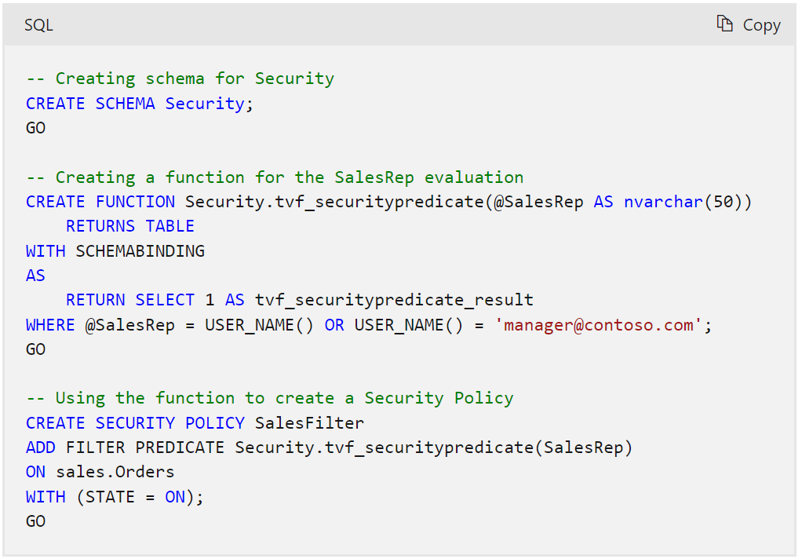
Security
Object Level Security
Allow/deny access on Workspace/Table/Column/Row
Column Level Security
GRANT SELECT ON Customers(CustomerID, FirstName, LastName, Phone, Email) TO [Charlie@contoso.com];
Row Level Security
Create function + Create Policy -> Assign Policy to table
Dynamic Data Masking
Similar to Synapse – define a masking function on a column level, grant/revoke mask/unmask to a user
Notes:
https://learn.microsoft.com/en-us/fabric/data-warehouse/dynamic-data-masking

Slide 12
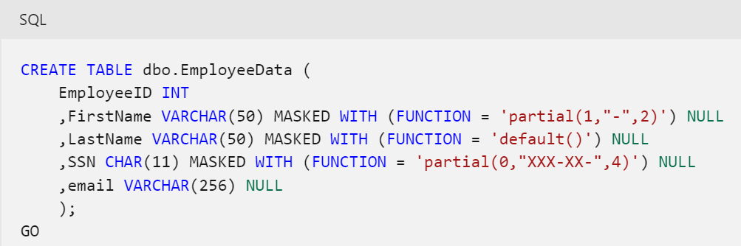
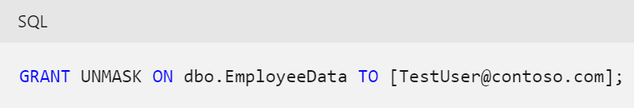
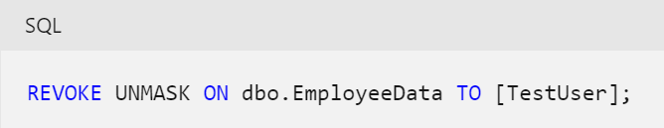
Dynamic Data Masking
Define mask on a column level
Grant UNMASK privilege to user/role
Revoke privilege from user/role
Notes:
https://learn.microsoft.com/en-us/fabric/data-warehouse/dynamic-data-masking

Slide 13
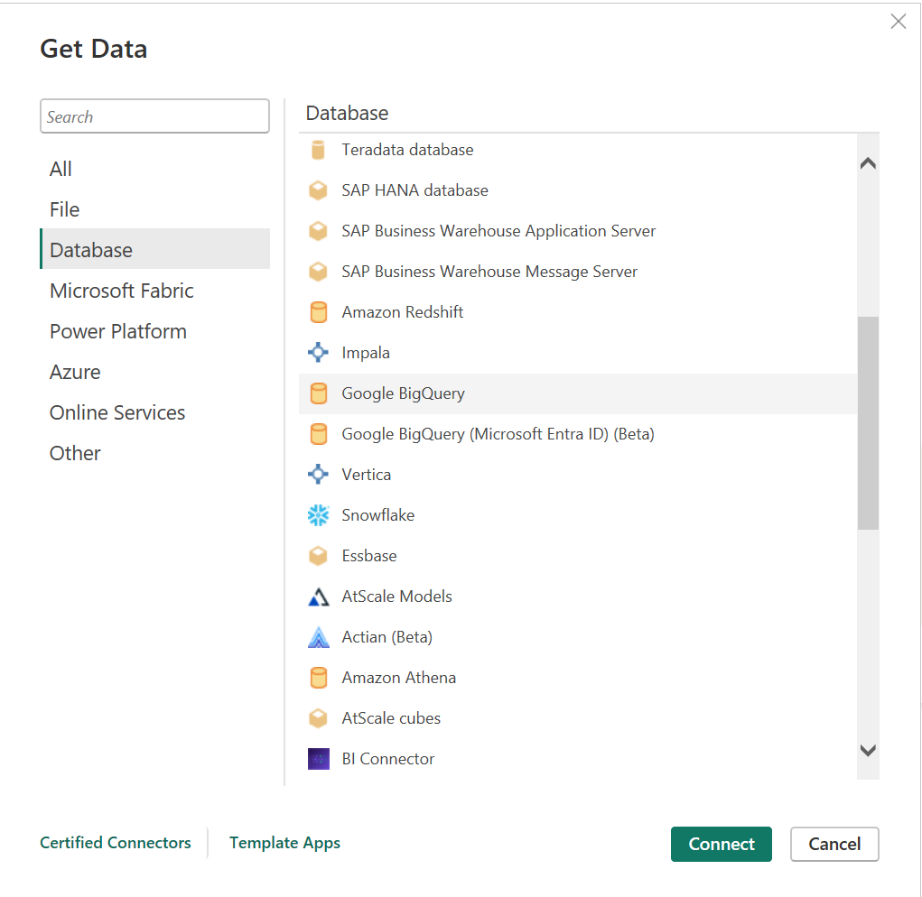
PowerBI Data Sources
Available Data Sources
150+ is available
Native Connectors
All MSFT sources
AWS Redshift
Oracle
Google Analytics/BigQuery
MariaDB
PostgreSQL

Slide 14
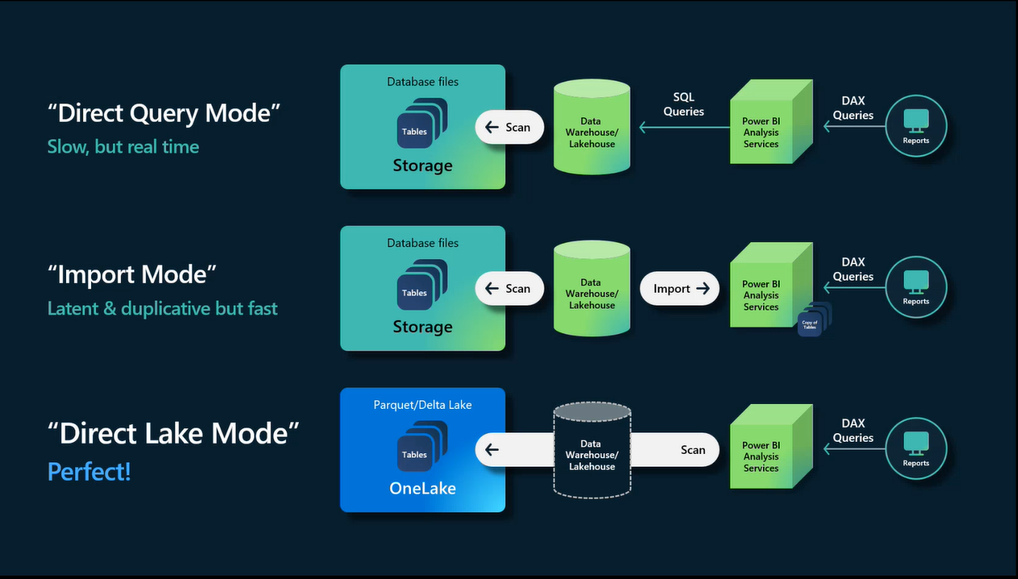
PowerBI Data Access

Slide 15
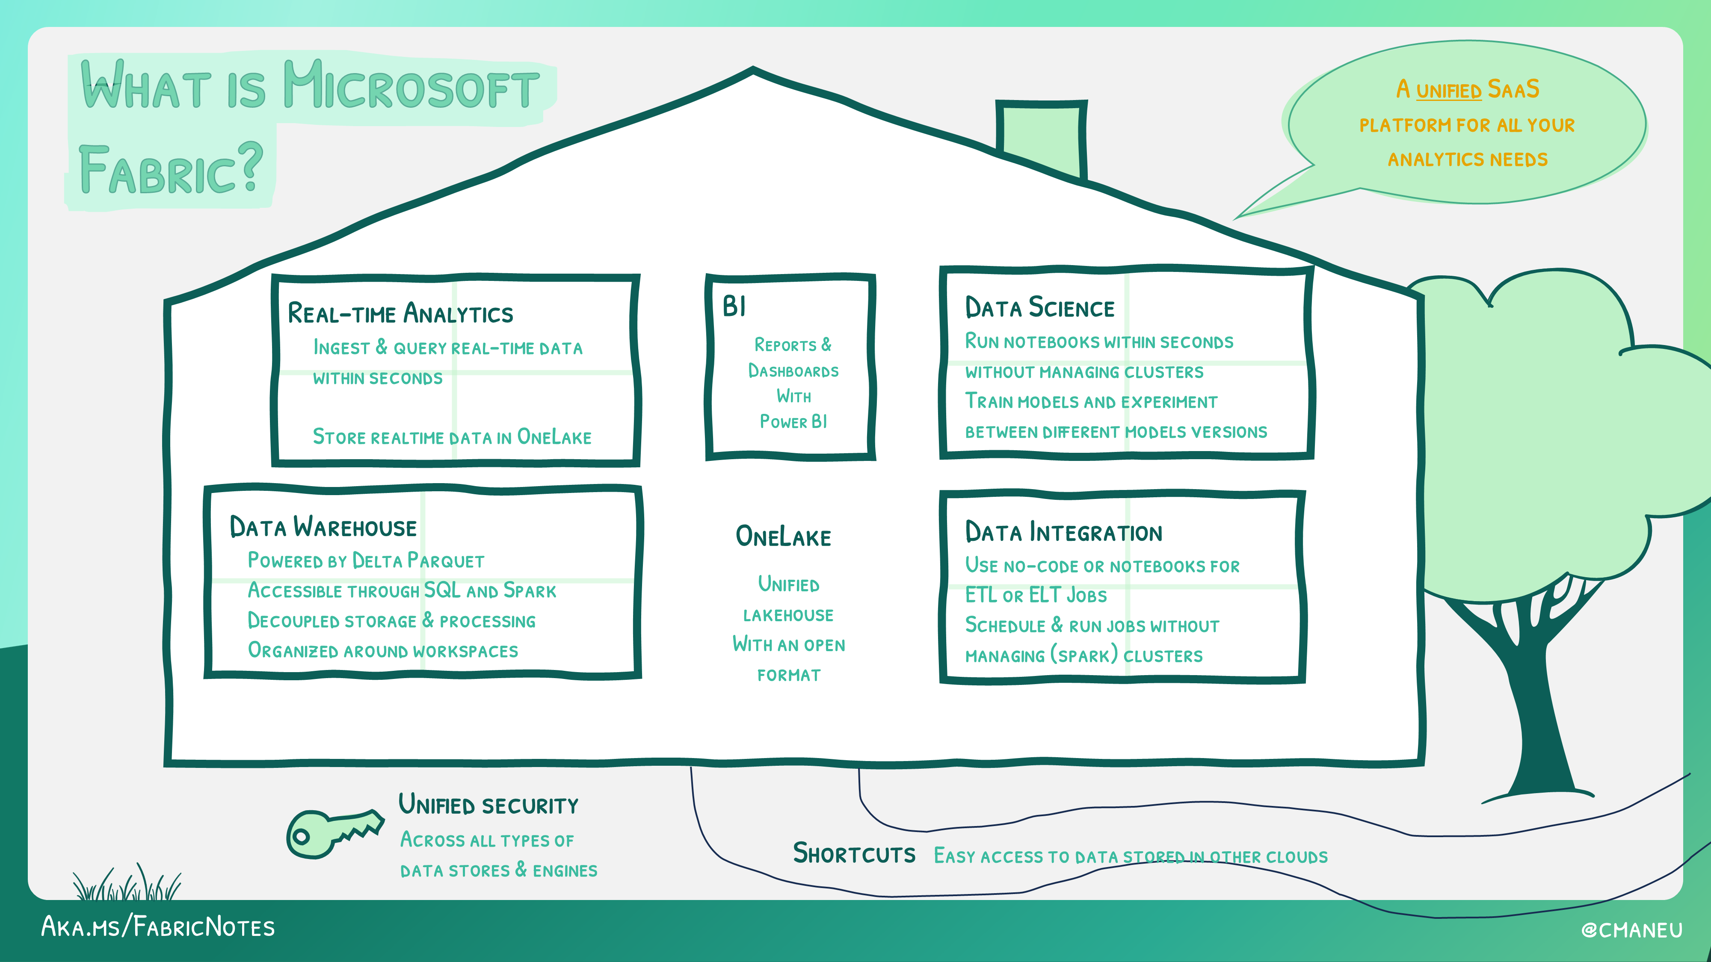
Notes:
Altogether
A significant upgrade to analytics engine: all around improved, faster and more scalable
Complete Analytics Platform combining:
Fabric SQL Engine - for standard workloads
Direct Lake - direct access to Lakehouse
Fabric Spark - run Spark workloads directly in Fabric
Real-Time Analytics - streaming and time series data analysis
Simplified Lakehouse architecture
Unified Open Source data format allows for using the data as is without copying
New Data Access options:
Shortcuts
Database mirroring
Seamless access to Dataverse and M365

Slide 16









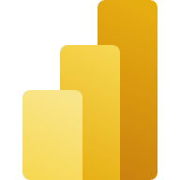


Data Engineers
Data Scientists
Data Analysts
Data Citizens
Execute faster with the ability to spin up a Spark VM cluster in seconds, or configure with familiar experiences like Git DevOps pipelines for data engineering artifacts
Streamline your work with a single platform to build and operate real-time analytics pipelines, data lakes, lake houses, warehouses, marts, and cubes using your preferred IDE, plug-ins, and tools.
Reduce costly data replication and movement with the ability to produce base datasets that can serve data analysts and data scientists without needing to build pipelines
Quickly tune a custom model by integrating a model built and trained in Azure ML in a Spark notebook
Work faster with the ability to user your preferred data science frameworks, languages, and tools
Bypass engineering dependencies with the ability to use your preferred no-code ML Ops to deploy and operate models in production
Tap into proven-at-scale models and services to accelerate your AI differentiation (AOAI, Cognitive Services, ONNX integration, etc).
Avoid slow, progress-stagnating data wrangling by seamlessly triggering a workflow that can unlock data engineering tools and capabilities quickly.
Accelerate your work with visual and SQL based tools for self-serve data transformations and modeling as well as self-serve tools for reporting, dashboards, and data visualizations
Turn data into impact with industry-leading BI tools and integration with the apps your people use everyday like Microsoft 365
Make more data-driven decisions with actionable insights and intelligence in your preferred applications
Maintain access to all the data you need, without being overwhelmed by data ancillary to your role thanks to fine grain data access management controls
Act on data, at scale and in a timely manner by describing business conditions in a no-code experience to launch actions such as Email, Teams notifications, Power Automate flows and call into third party action systems.
Serve data via warehouse or lakehouse
Serve transformed data
Serve insights via embedding
Supporting experiences:
Supporting experiences
Supporting experiences
Supporting experiences
Data Factory
Data Warehouse
Data Science
Azure ML
Data Warehouse
Real-time Analytics
Power BI
Power BI
Data Activator
Microsoft 365
Data Engineering
Real-time Analytics
Serve data via warehouse or lakehouse
Data Stewards
Maintain visibility and control of costs with a unified consumption and cost model that provides evergreen spend optics on your end-to-end data estate
Gain full visibility and governance over your entire analytics estate from data sources and connections to your data lake, to users and their insights
Notes:
Envisioned personas

Slide 17
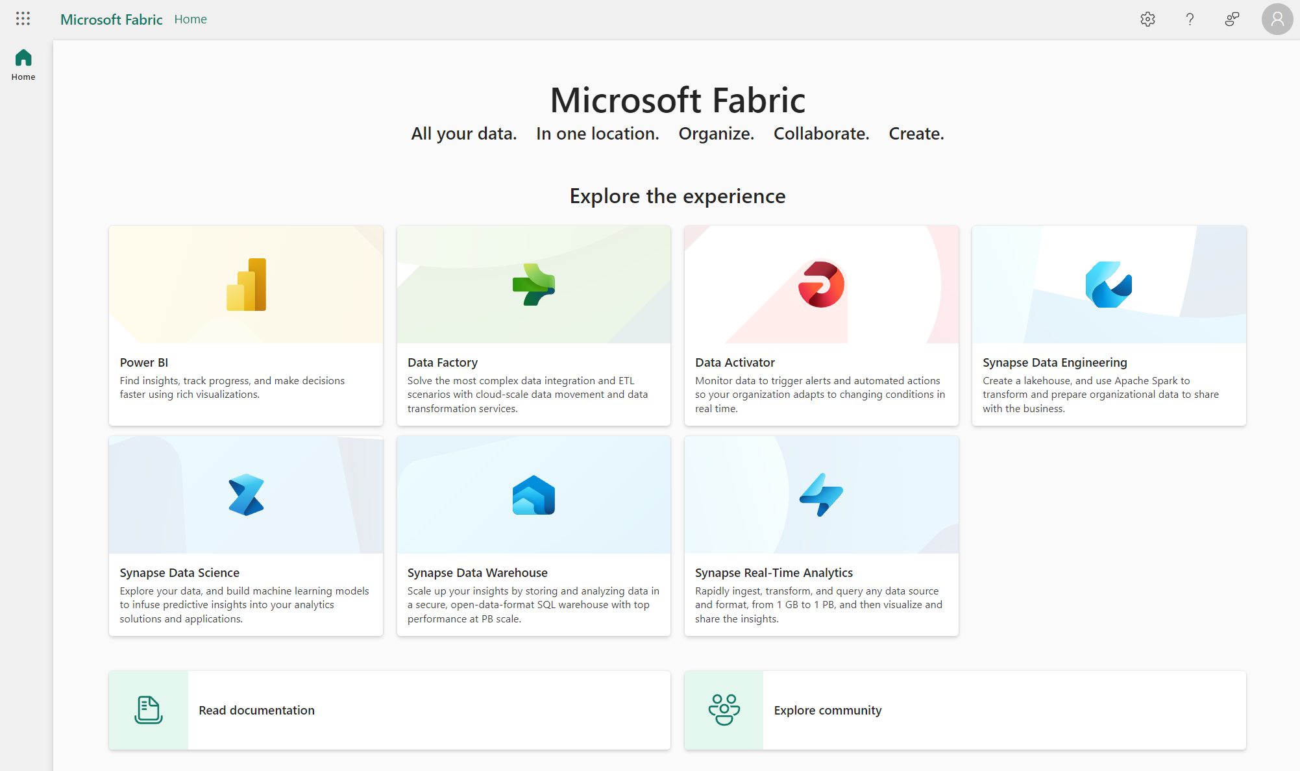
Notes:
Fabric User Interface is centered around Persona experience

Slide 18
Report Demo

Slide 19
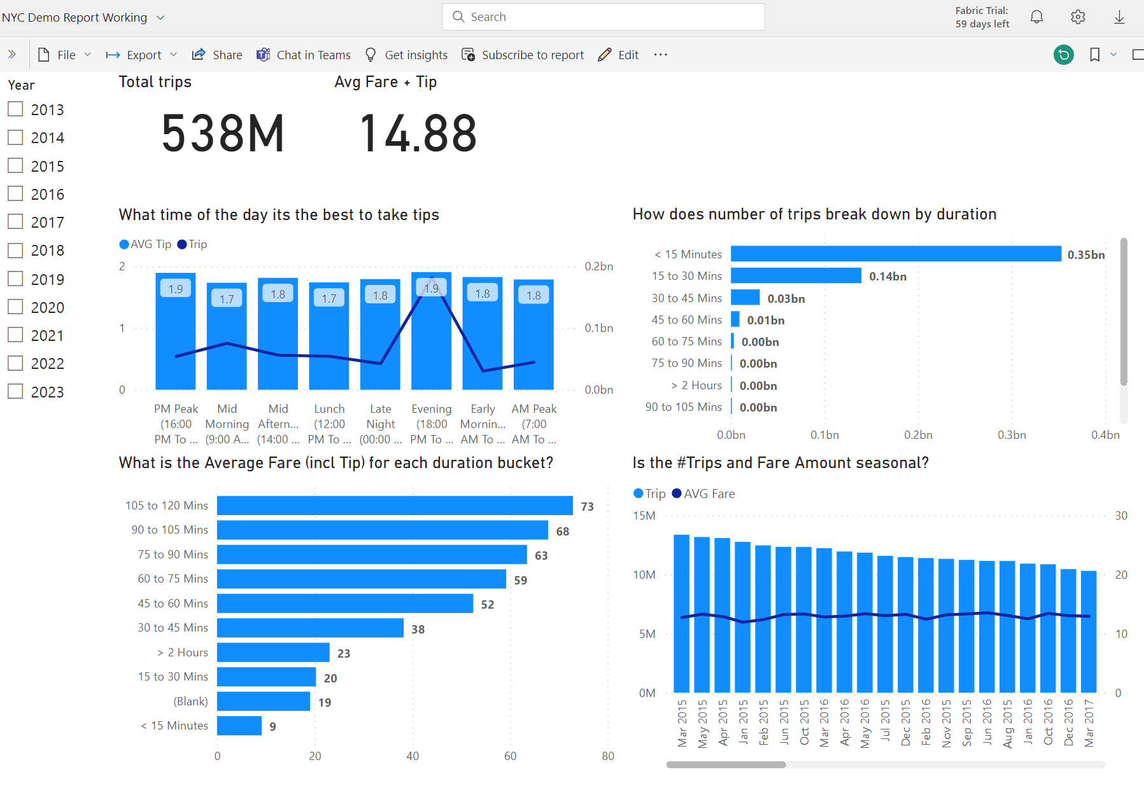
Report Demo
Direct Lake
New mode for large data volume
Overview
NYC Yellow Dataset
Parquet format
36Gb size
1.5 Million rows (538M filtered)
Notes:
https://app.powerbi.com/groups/3d4eb8f2-f109-4301-a87e-be61e4f77563/reports/10bf55aa-5026-4cf4-b6d9-ae3f8c6a7bc6/ReportSection?experience=power-bi
Direct Lake mode is a groundbreaking new dataset capability for analyzing very large data volumes in Power BI. Direct Lake is based on loading parquet-formatted files directly from a data lake without having to query a Lakehouse endpoint, and without having to import or duplicate data into a Power BI dataset. Direct Lake is a fast-path to load the data from the lake straight into the Power BI engine, ready for analysis. The following diagram shows how classic import and DirectQuery modes compare with the new Direct Lake mode
Direct Lake is supported on Power BI Premium P and Microsoft Fabric F SKUs only. It's not supported on Power BI Pro, Premium Per User, or Power BI Embedded A/EM SKUs.

Slide 20
Fabric Pricing

Slide 21
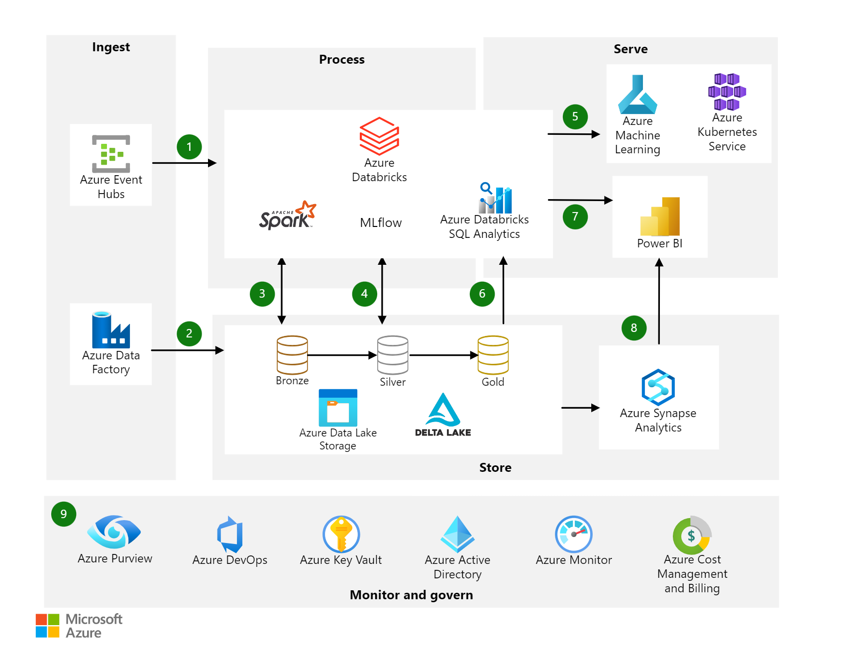

Slide 22
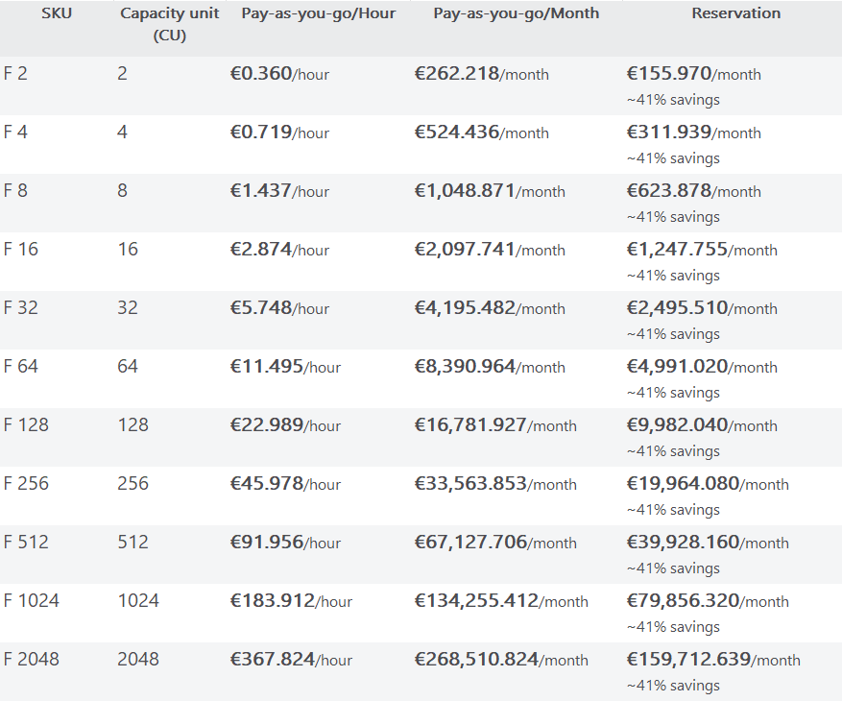
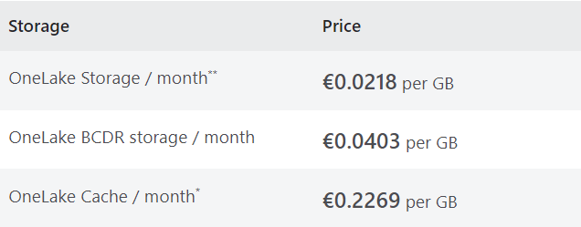
Microsoft Fabric Pricing
Fabric Capacity
Compute for fabric workloads
Spark Compute included
Networking
Cross-region data transfer may apply
Storage
Pricing
Fabric Capacity Reservations
22/11/2023, for North Europe region
Notes:
Pricing is a sum of following factors: Capacity + Storage and potentially Networking (in case if you’re working with data from multiple regions).
Publishing/authoring reports requires PowerBI Pro license for all SKUs.
F64 SKU is similar to PowerBI Premium capacity.
Reservations – reserves Fabric capacity for 12 months period.
Pricing
https://azure.microsoft.com/en-us/pricing/details/microsoft-fabric/
Save costs with Microsoft Fabric Capacity reservations
https://learn.microsoft.com/en-us/azure/cost-management-billing/reservations/fabric-capacity
(content sharing to users without a per-user licence is available only at Fabric SKUs F64 and above).
Two options:
PAYG
Reserved capacity (similar price to PowerBI Pro) – coming later

Slide 23
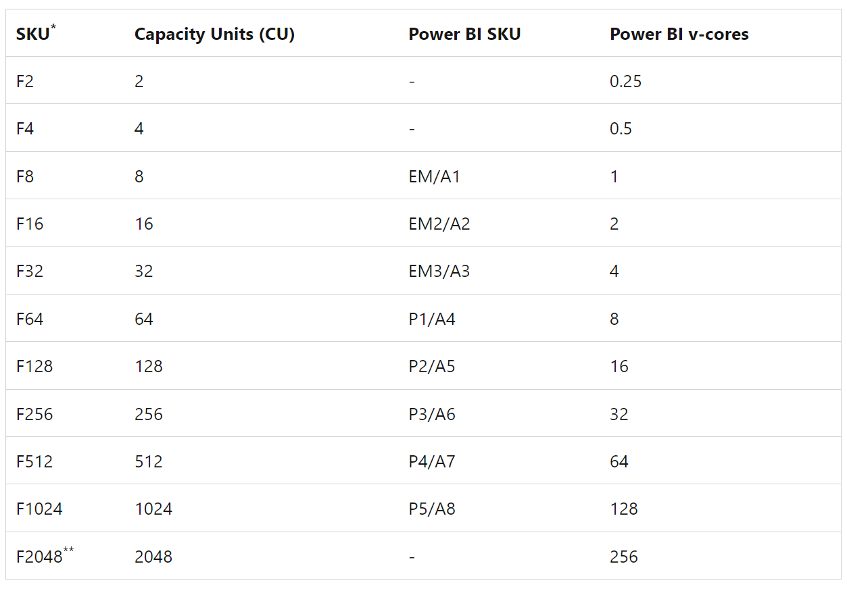
F64 Capacity
Fabric Premium Capacity
Share reports in Premium Capacity
Included in MACC
Direct Lake
Fast Reporting over very large datasets
Query Data Lake Directly
Report Model Sizing
100Tb Maximum Storage (all models)
400Gb Max Model Size
Notes:
Formerly known as PowerBI premium
Direct Lake
https://learn.microsoft.com/en-us/power-bi/enterprise/directlake-overview
Unlimited number of Reader Report users
Spark Compute time for ETL included
Direct Lake - allows reports from large datasets
Smoothing - flattens Compute usage over time to allow for usage spikes
Maximum Storage - 100Tb
Maximum Model Size - 400Gb
What is Power BI Premium?
https://learn.microsoft.com/en-us/power-bi/enterprise/service-premium-what-is

Slide 24
Resource guardrails and MaxMemory
SKU | Max memory (GB)1, 2 | Max concurrent DirectQuery connections (per semantic model)1 | Live connection (per second)1 | Max memory per query (GB)1 | Model refresh parallelism | Direct Lake rows per table (in millions)1, 3 | Max Direct Lake model size on OneLake (GB)1, 3 | Parquet files per table | Row groups per table | Rows per table (millions) | Max model size on disk/OneLake1 (GB)
F2 | 3 | 5 | 2 | 1 | 1 | 300 | 10 | 1,000 | 1,000 | 300 | 10
F4 | 3 | 5 | 2 | 1 | 2 | 300 | 10 | 1,000 | 1,000 | 300 | 10
F8 | 3 | 10 | 3.75 | 1 | 5 | 300 | 10 | 1,000 | 1,000 | 300 | 10
F16 | 5 | 10 | 7.5 | 2 | 10 | 300 | 20 | 1,000 | 1,000 | 300 | 20
F32 | 10 | 10 | 15 | 5 | 20 | 300 | 40 | 1,000 | 1,000 | 300 | 40
F64 | 25 | 50 | 30 | 10 | 40 | 1,500 | Unlimited | 5,000 | 5,000 | 1,500 | Unlimited
F128 | 50 | 75 | 60 | 10 | 80 | 3,000 | Unlimited | 5,000 | 5,000 | 3,000 | Unlimited
F256 | 100 | 100 | 120 | 10 | 160 | 6,000 | Unlimited | 5,000 | 5,000 | 6,000 | Unlimited
F512 | 200 | 200 | 240 | 20 | 320 | 12,000 | Unlimited | 10,000 | 10,000 | 12,000 | Unlimited
F1024 | 400 | 200 | 480 | 40 | 640 | 24,000 | Unlimited | 10,000 | 10,000 | 24,000 | Unlimited
F2048 | 400 | 200 | 960 | 40 | 1,280 | 24,000 | Unlimited | 10,000 | 10,000 | 24,000 | Unlimited
Notes:
https://learn.microsoft.com/en-us/power-bi/enterprise/service-premium-what-is#semantic-model-sku-limitation
https://learn.microsoft.com/en-us/power-bi/enterprise/directlake-overview#fallback
Guardrails
https://learn.microsoft.com/en-us/power-bi/enterprise/directlake-overview#fallback
Power BI semantic models in Direct Lake mode read delta tables directly from OneLake. However, if a DAX query on a Direct Lake model exceeds limits for the SKU, or uses features that don’t support Direct Lake mode, like SQL views in a Warehouse, the query can fall back to DirectQuery mode. In DirectQuery mode, queries use SQL to retrieve the results from the SQL endpoint of the Lakehouse or Warehouse, which can impact query performance. You can disable fallback to DirectQuery mode if you want to process DAX queries in pure Direct Lake mode only. Disabling fallback is recommended if you don’t need fallback to DirectQuery. It can also be helpful when analyzing query processing for a Direct Lake model to identify if and how often fallbacks occur. To learn more about DirectQuery mode, see Semantic model modes in the Power BI service.
Guardrails define resource limits for Direct Lake mode beyond which a fallback to DirectQuery mode is necessary to process DAX queries. For details about how to determine the number of parquet files and row groups for a delta table, refer to the Delta table properties reference.
For Direct Lake semantic models, Max Memory represents the upper memory resource limit for how much data can be paged in. In effect, it's not a guardrail because exceeding it does not cause a fallback to DirectQuery; however, it can have a performance impact if the amount of data is large enough to cause paging in and out of the model data from the OneLake data.
SKU computing power
https://learn.microsoft.com/en-us/power-bi/developer/embedded/embedded-capacity#sku-computing-power
¹ These SKUs aren't available in all regions. To request using these SKUs in regions where they're not available, contact your Microsoft account manager.
More information about SKU limits, is available here:
F SKUs - Microsoft Fabric licenses.
SKU limits in Power BI - What is Power BI Premium?
Power BI interactive (not paginated) reports - Export Power BI report to file.
Note the amount of memory available on each node size described in the RAM (GB) column of the table. It's set to the memory footprint limit of a single Power BI item (such as a semantic model, report or dashboard), and not to the cumulative consumption of memory. For example, in an Embedded A4 capacity, a single dataset size is limited to 25 GB, and not the total memory footprint of all datasets handled at the same time.

Slide 25
Resource guardrails and MaxMemory
SKU | Power BI SKU | Capacity Units (CU) | Power BI v-cores | Parquet files per table | Row groups per table | Rows per table (millions) | Max model size on disk/OneLake1 (GB) | Max memory (GB)
F2 | N/A | 2 | N/A | 1,000 | 1,000 | 300 | 10 | 3
F4 | N/A | 4 | N/A | 1,000 | 1,000 | 300 | 10 | 3
F8 | EM1/A1 | 8 | 1 | 1,000 | 1,000 | 300 | 10 | 3
F16 | EM2/A2 | 16 | 2 | 1,000 | 1,000 | 300 | 20 | 5
F32 | EM3/A3 | 32 | 4 | 1,000 | 1,000 | 300 | 40 | 10
F64/FT1/P1 | P1/A4 | 64 | 8 | 5,000 | 5,000 | 1,500 | Unlimited | 25
F128/P2 | P2/A5 | 128 | 16 | 5,000 | 5,000 | 3,000 | Unlimited | 50
F256/P3 | P3/A6 | 256 | 32 | 5,000 | 5,000 | 6,000 | Unlimited | 100
F512/P4 | P4/A7 | 512 | 64 | 10,000 | 10,000 | 12,000 | Unlimited | 200
F1024/P5 | P5/A8 | 1,024 | 128 | 10,000 | 10,000 | 24,000 | Unlimited | 400
F2048 | N/A | 2,048 | N/A | 10,000 | 10,000 | 24,000 | Unlimited | 400
Notes:
Guardrails
https://learn.microsoft.com/en-us/power-bi/enterprise/directlake-overview#fallback
Power BI semantic models in Direct Lake mode read delta tables directly from OneLake. However, if a DAX query on a Direct Lake model exceeds limits for the SKU, or uses features that don’t support Direct Lake mode, like SQL views in a Warehouse, the query can fall back to DirectQuery mode. In DirectQuery mode, queries use SQL to retrieve the results from the SQL endpoint of the Lakehouse or Warehouse, which can impact query performance. You can disable fallback to DirectQuery mode if you want to process DAX queries in pure Direct Lake mode only. Disabling fallback is recommended if you don’t need fallback to DirectQuery. It can also be helpful when analyzing query processing for a Direct Lake model to identify if and how often fallbacks occur. To learn more about DirectQuery mode, see Semantic model modes in the Power BI service.
Guardrails define resource limits for Direct Lake mode beyond which a fallback to DirectQuery mode is necessary to process DAX queries. For details about how to determine the number of parquet files and row groups for a delta table, refer to the Delta table properties reference.
For Direct Lake semantic models, Max Memory represents the upper memory resource limit for how much data can be paged in. In effect, it's not a guardrail because exceeding it does not cause a fallback to DirectQuery; however, it can have a performance impact if the amount of data is large enough to cause paging in and out of the model data from the OneLake data.
SKU computing power
https://learn.microsoft.com/en-us/power-bi/developer/embedded/embedded-capacity#sku-computing-power
¹ These SKUs aren't available in all regions. To request using these SKUs in regions where they're not available, contact your Microsoft account manager.
More information about SKU limits, is available here:
F SKUs - Microsoft Fabric licenses.
SKU limits in Power BI - What is Power BI Premium?
Power BI interactive (not paginated) reports - Export Power BI report to file.
Note the amount of memory available on each node size described in the RAM (GB) column of the table. It's set to the memory footprint limit of a single Power BI item (such as a semantic model, report or dashboard), and not to the cumulative consumption of memory. For example, in an Embedded A4 capacity, a single dataset size is limited to 25 GB, and not the total memory footprint of all datasets handled at the same time.

Slide 26
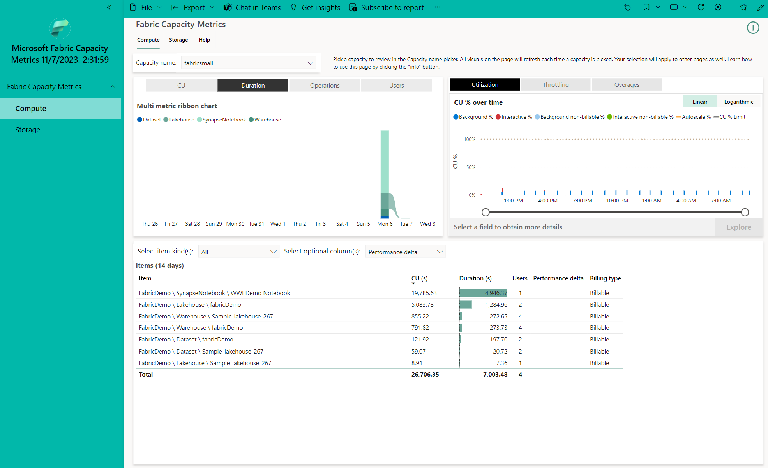
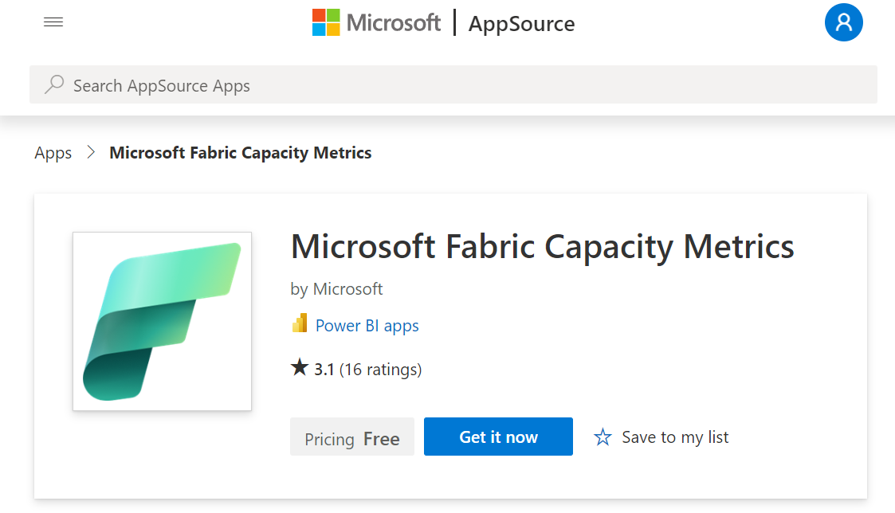
Sizing
Install Fabric Capacity Metrics App
Notes:
https://learn.microsoft.com/en-us/fabric/enterprise/metrics-app-install?tabs=1st

Slide 27
Enable Fabric in your tenant

Slide 28
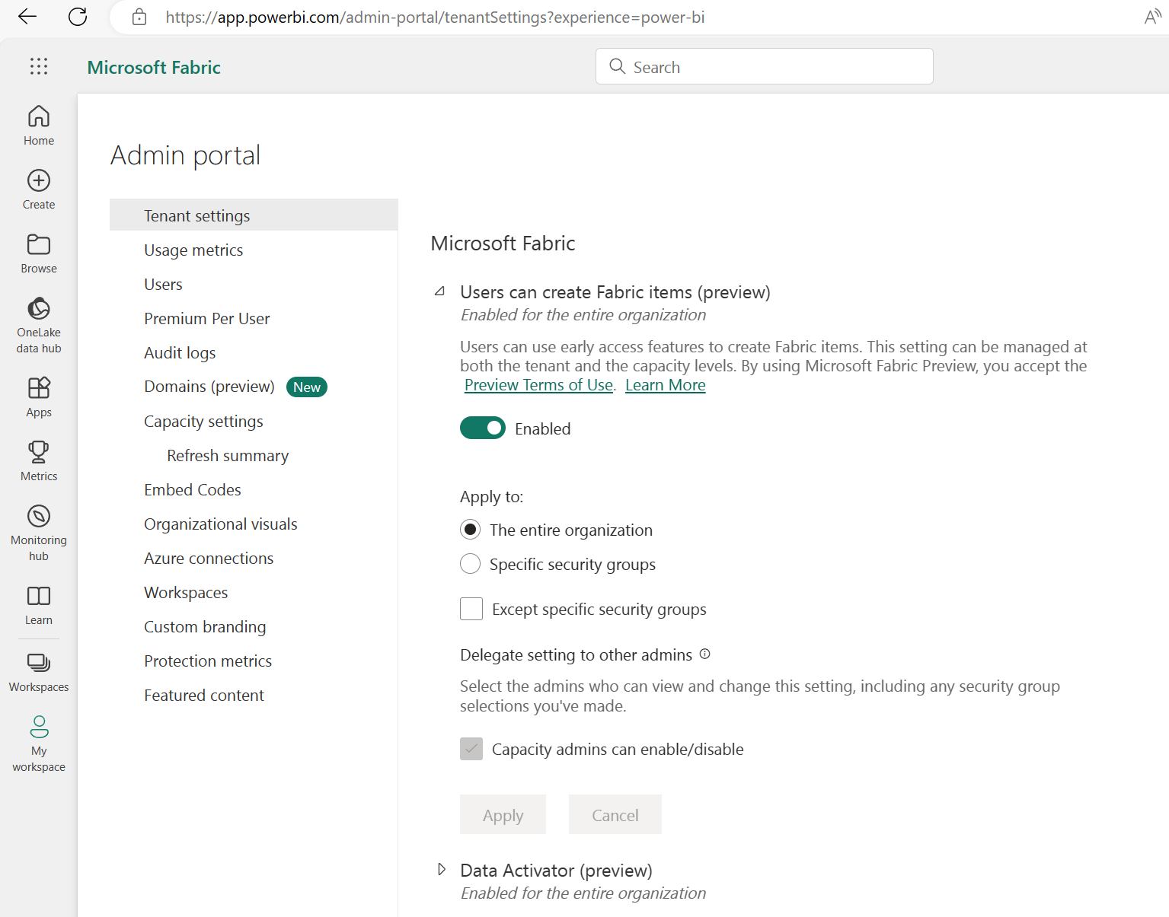
Fabric
Administrator settings
Enable Fabric functionality for all users or per security group

Slide 29
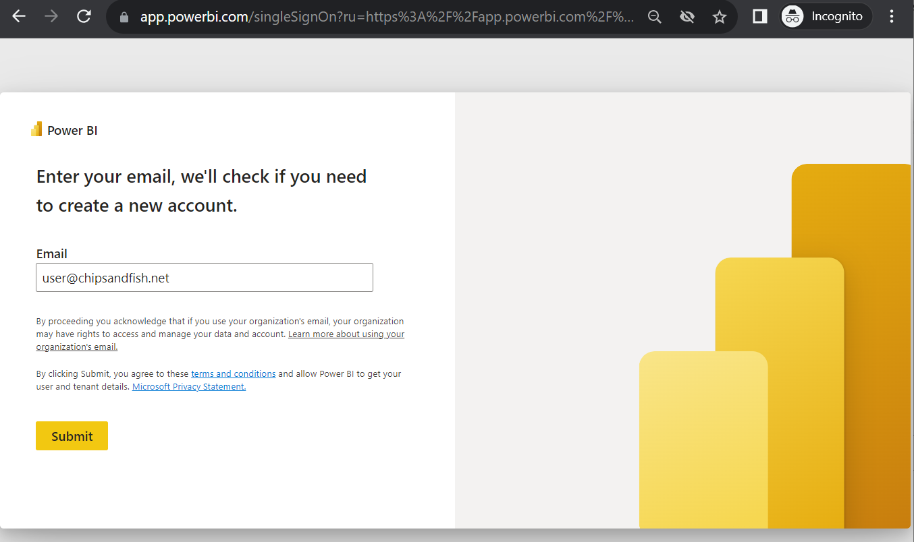
Fabric
User Sign Up experience
Navigate to
https://app.powerbi.com

Slide 30
Fabric Scenarios

Slide 31

Fabric analytics scenarios
lakehouse-vs-warehouse
Lakehouse
Data Warehouse
Data Science
Real Time Analytics
OneLake
Notes:
Microsoft Fabric supports four common end-to-end analytics scenarios:
Lakehouse
Data Warehouse
Data Science
Real Time Analytics
Keep in mind that while these are the most common scenarios supported by Microsoft Fabric, there are many others that technical and business end-users can navigate through.

Slide 32
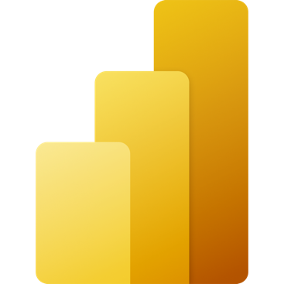
Lakehouse
Data Source
Ingestion
Store
Expose
Direct
lake
PBI
Microsoft &
Other clouds
Shortcuts
Lakehouse(s)
SQL-endpoint
Structured / Unstructured
Pipelines & Dataflows
Lake Warehouse
Transform
Notebooks & Dataflows
Notes:
The Microsoft Fabric Lakehouse analytics scenario makes it so that data can be ingested into OneLake with shortcuts to other clouds repositories, pipelines, and dataflows in order to allow end-users to leverage other data.
Once that data has been pulled into Microsoft Fabric, users can leverage notebooks to transform that data in OneLake and then store them in Lakehouses with medallion structure.
From there, users can begin to analyze and visualize that data with Power BI using the see-through mode or SQL endpoints.

Slide 33
Data warehouse
Data Source
Ingestion
Store
Expose
Shortcut Enabled
Mounts
Data Warehouse
PBI
Structured / Unstructured
Pipelines & Dataflows
Warehouse
Transform
Procedures
Notes:
The Data Warehouse analytics scenario takes existing sources that are mounted, while pipelines and dataflows can bring in all other data that is needed.
IT teams can then define and store procedures to transform the data, which is stored as Parquet/Delta Lake files in OneLake.
From there, business users can analyze and visualize data with Power BI, again using the see-through mode or SQL endpoints.

Slide 34
Real time analytics
Data Source
Ingestion
Store
Expose
Lakehouse & Data Warehouse
CI & Shortcuts
Kusto DB
PBI
Structured / Unstructured
Pipeline & Dataflows
Kusto Query
Event Streaming
Mirror
Notebook
Lakehouse & Data Warehouse
ML Model
Notes:
Unlike the Data Science, Lakehouse, and Data Warehouse analytics scenarios, streaming data can be ingested into the Microsoft Fabric in several ways to achieve real-time analytics.
Users can leverage Event Hub, IoT Hub, pipelines, dataflows, notebooks, or open-source products like Kafka, Logstash, and more.
Once ingested into the Microsoft Fabric, streaming data can be stored in Kusto DB and mirrored into Lakehouse. After the data has been stored, machine learning models can be trained and tested directly on the Lakehouse with experiments.
Like the other scenarios, business users can analyze and visualize the data with Power BI using the see-through mode or SQL endpoints. Data can also be exposed through KQL or notebooks using Spark.

Slide 35
Data science
Data Source
Clean & prepare
Store
Expose
Lakehouse & Data Warehouse
Notebooks
Lakehouse(s)
PBI
Train test & apply
Lake Warehouse
Models
Experiments
Notes:
The Data Science analytics scenario can be ingested similarly to the Lakehouse and Data Warehouse paths.
Once the data is ingested, it is cleaned and prepared using notebooks and then stored in the Lakehouse with medallion structure.
After the data is cleaned and stored, machine learning models can be trained and tested directly on the Lakehouse.
Like the other analytics scenarios, business users can analyze and visualize the data with Power BI using the see-through mode or SQL endpoints.

Slide 36
Other resources

Slide 37
Copilot in PowerBI Video
https://www.youtube.com/watch?v=wr__6tM5U6I
Notes:
https://www.youtube.com/watch?v=wr__6tM5U6I

Slide 38
Additional Resources
https://Aka.ms/FabricLicensing
aka.ms/FabricRoadmap
Notes:
https://learn.microsoft.com/en-us/fabric/enterprise/licenses

Slide 39
Microsoft Fabric
Microsoft Synapse
Data Factory
Synapse
Data Engineering
Synapse
Data Science
Synapse
Data Warehouse
Synapse
Real-Time Analytics
Power BI
Data Activator
OneLake
Notes:
Vs Synapse comparison short
Azure Data Factory provides a standalone experience for creating Pipelines.

Slide 40
Fabric vs Synapse, Nov’23
Fabric
Pros
SaaS
PowerBI included in price
Consolidated feature set
Scalable compute
Combined Compute: Spark, Analytics and PBI
Includes Data Activator
Includes Synapse capabilities (*)
Integrated Persona experience
Native MLFlow endpoint
Cons
(*) Active Development
No Synapse Link
Synapse
Pros
More flexible deployment
Serverless pools vs Dedicated Pools
Separately provisioned Compute for Spark, DWH
Mature
Synapse Link for (SQL, CosmosDb, etc)
Cons
Azure Synapse Studio
Azure portal for infra management
PaaS
Prev Gen
Notes:
Fabric is Microsoft Azure Consumption Commitment (MACC) eligible.
https://powerbi.microsoft.com/en-au/pricing/
Data Activator
Data Activator is a no-code experience in Microsoft Fabric for automatically taking actions when patterns or conditions are detected in changing data. It monitors data in Power BI reports and Eventstreams items, for when the data hits certain thresholds or matches other patterns. It then automatically takes appropriate action such as alerting users or kicking off Power Automate workflows.
For Synapse, Data Activator can be realised with stream processing tech Kafka, Event Hubs, etc

Slide 41
One Lake
Storage features
Shortcuts
External Tables
Stored Anywhere
Many File Formats
PARQUET
CSV
AVRO
JSON
Delta Tables
Fast
Compliance built-in
Notes:
File Formats:
And any Apache Hive supported formats as expected.

Slide 43
Microsoft Fabric Pricing
Asdfasdfasdf

